Slide 1
Adaptive Financial Security Framework: Implementing Advanced QR-Based Authentication to Prevent Unauthorized ATM Transactions.
SURYA PRAKASH R (412021205004)
GUIDED BY
Prof.Dr.S.N SHEELA EVANGELIN PRASAD.,

Slide 2
ABSTRACT
This project introduces a Smart QR-Based ATM system aimed at making banking faster and more secure. Traditional ATM transactions using cards and PINs are often slow and vulnerable to fraud. To solve this, our system allows users to use a mobile app to enter the withdrawal amount and generate a temporary PIN and a QR code. The QR code, containing transaction details, is scanned at the ATM for a quick and secure withdrawal within 30 seconds. Using Python for QR code generation and scanning, the system offers a safe, efficient, and user-friendly alternative to traditional methods, enhancing both security and user experience. It reduces the chances of unauthorized access and ensures that transactions are completed with minimal contact and maximum convenience. This approach modernizes ATM usage, aligning with the evolving needs of digital banking. Additionally, it supports faster service at ATM terminals and minimizes physical touchpoints, making it ideal for both security and hygiene. The system represents a step forward in smart banking by combining technology, safety, and user-centered design.

Slide 3
INTRODUCTION
Today, digital banking has made it easier for people to manage their money. ATMs are still widely used, but the usual method of using cards and PINs can be slow and unsafe.
To make ATM use faster and more secure, this project introduces a Smart QR-Based ATM system. Instead of using a card, users will use a mobile app to enter the amount they want and get a temporary PIN and QR code.
This QR code is scanned at the ATM, and the user enters the PIN to complete the transaction in less than 30 seconds. This helps stop fraud like card skimming and saves time.
The system uses Python to create and read QR codes, making it simple and effective. It also reduces the need for physical contact, making ATM use safer during health-sensitive times. This project aims to improve the way people access cash with speed, safety, and ease.

Slide 4
EXISTING SYSTEM
The current ATM system requires users to insert their bank card and enter a PIN to withdraw cash. Although this method has been used for many years, it has several drawbacks. The process is often slow because users must go through many steps, which can be confusing for elderly people or those using the ATM for the first time. ATMs also get crowded during busy hours, leading to long waiting times. In terms of security, traditional ATMs are not very safe. Criminals can use hidden devices to steal card information, and PINs can be seen by others or captured by hidden cameras. If someone gets both the card and PIN, they can withdraw money without the user’s permission. Another issue is that users rely on physical cards, which can be lost, stolen, or damaged. Lastly, traditional ATMs only offer basic features like balance inquiry and cash withdrawal. They do not connect with mobile apps or digital wallets, making it harder for users to manage their accounts in real-time.

Slide 5
DISADVANTAGE
Time-Consuming Process Users must follow multiple steps like inserting a card, entering a PIN, and selecting options, which takes time and can cause delays, especially during peak hours.
Security Risks Traditional ATMs are vulnerable to card skimming, PIN theft, and fraud if someone gains access to both the card and the PIN.
Dependence on Physical Cards If a card is lost, stolen, damaged, or expired, users cannot access their money until they get a replacement, which may take time and involve extra charges.

Slide 6
LITERATURE SURVEY
S.NO | TITLE | DISADVANTAGE
1 | Invasion And Evolution Of QR Code | QR codes can be unsafe if not checked properly, as they may lead to fake links or steal personal information.
2 | Unique System For Robotic Localization Using QR Markers In Indoor Environments | The system may not work well if QR markers are hard to see due to poor lighting, obstacles, or damage..
3 | Streaming QR codes | Streaming QR codes may not work properly if the camera is shaky, the lighting is poor, or the network is slow.
4 | Urban Cleanliness Using Technology | Relying on technology for urban cleanliness may fail due to high costs, technical issues, or lack of proper maintenance and user awareness.

Slide 7
PROPOSED SYSTEM
The proposed Smart QR-Based ATM system uses modern technology to improve the traditional ATM process by making it faster, safer, and easier to use. Instead of inserting a card and entering a PIN, users can simply use a mobile app to start a withdrawal. Through the app, they can log in securely and choose the amount they want to withdraw before reaching the ATM. The app then creates a special one-time PIN that works only for a short time, adding extra protection against PIN theft. It also generates a secure QR code with the transaction details. At the ATM, the user scans this QR code to quickly complete the transaction without using a card or typing a PIN. This system reduces waiting time, improves safety, and offers a smooth user experience. It also helps avoid physical contact with ATM surfaces, which is especially useful for hygiene. Overall, this system brings ATM usage in line with modern digital banking standards.

Slide 8
ADVANTAGES
Enhanced Security – Uses one-time PINs and encrypted QR codes, reducing risks of card skimming and PIN theft.
Faster Transactions – Withdrawals are completed in under 30 seconds, minimizing wait times.
Cardless Convenience – No need to carry or insert a physical card, preventing issues from lost or damaged cards.
Touch-Free Operation – Reduces contact with ATM surfaces, promoting hygiene and user safety.

Slide 9
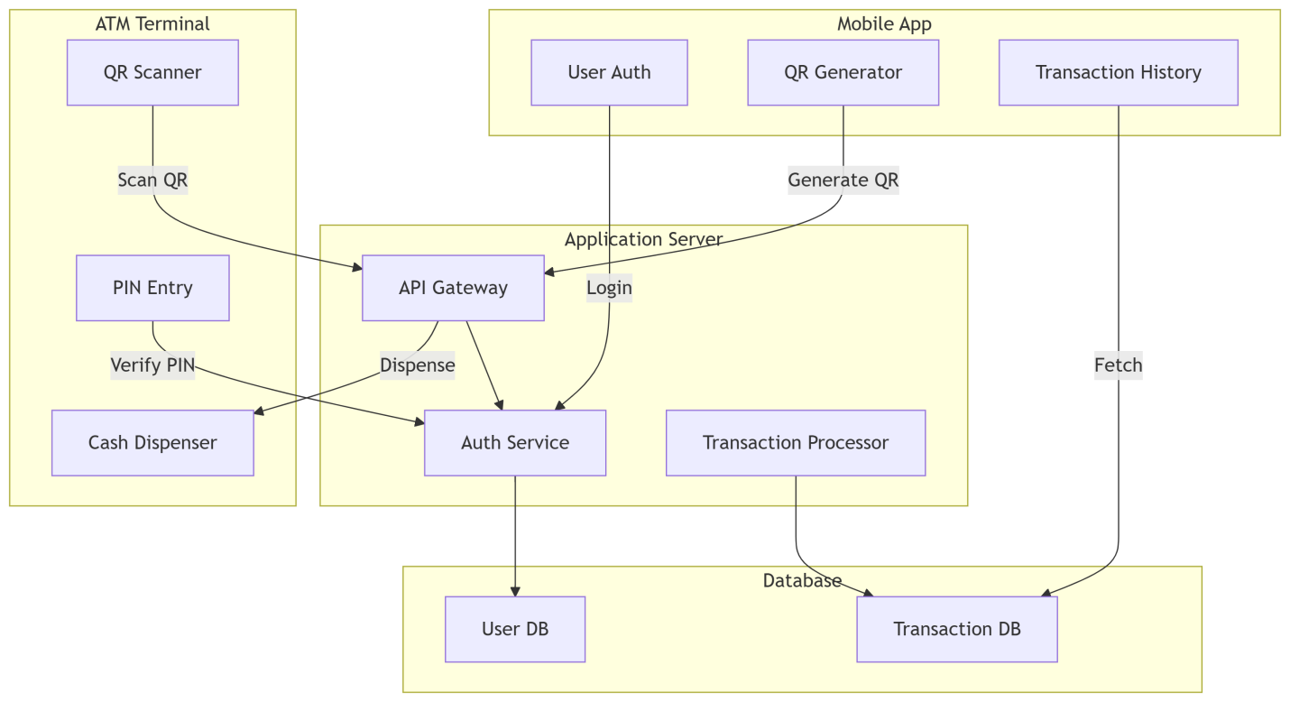
SYSTEM ARCHITECTURE

Slide 10
SYSTEM MODULE
Module 1: Mobile application module
Module 2: QR Code Processing Module
Module 3: Security And Authentication Module

Slide 11
MODULE DESCRIPTIONS
Module 1: Mobile application module
Cardless and Quick Transactions: Users can initiate ATM withdrawals from their smartphones, removing the need for physical bank cards and reducing time at the ATM.
User-Friendly Design: The app is designed to be simple and accessible, making it easy for users of all tech skill levels to navigate.
Pre-Configured Withdrawals: Users can log in, choose the amount, and prepare the transaction before reaching the ATM, enabling withdrawals in under 30 seconds.
Seamless Integration and Modern Banking: The app integrates with other system components like QR code generation and supports the shift toward mobile and digital banking.

Slide 12
MODULE DESCRIPTIONS
Module 2: QR Code Processing Module
Fast and Contactless Transactions: The module enables withdrawals in under 30 seconds by scanning QR codes, eliminating the need for card insertion and reducing physical contact.
Secure QR Code Generation: Uses Python with OpenCV and Pillow to create QR codes that securely encode user and transaction details.
Improved Security: Prevents card skimming and related fraud by removing the need for physical cards during ATM use.
Accurate and Efficient Processing: Quickly encodes and decodes transaction data to ensure smooth, reliable performance, supporting a modern and safe ATM experience.

Slide 13
MODULE DESCRIPTIONS
Module 3: Security And Authentication Module
Dual-Layered Security: Combines a one-time, temporary PIN and encrypted QR codes to protect against common threats like PIN theft and card skimming.
Prevents Unauthorized Access: Temporary PINs are valid for one transaction only, making it impossible to reuse them even if intercepted.
Enhances User Trust: Real-time authentication confirms the user's identity and transaction details, boosting confidence in digital banking.
Fights Modern ATM Fraud: The system removes the need for physical cards, reducing exposure to skimming devices and aligning with the latest security standards.

Slide 14
SOFTWARE REQUIREMENTS
Operating System : Windows 10 (64 bit) or 11 (64 bit)
Software : Python (3.10 or higher) IDE (like IDLE or VS Code)
Tools : Flask, OpenCV, Pillow (PIL) , qrcode / PyQRCode, pyzbar, HTML, CSS, and JavaScript

Slide 15
HARDWARE REQUIREMENTS
Hard Disk : 500GB and above
RAM : 8GB and above
Processor : Intel Core i5 and above

Slide 16
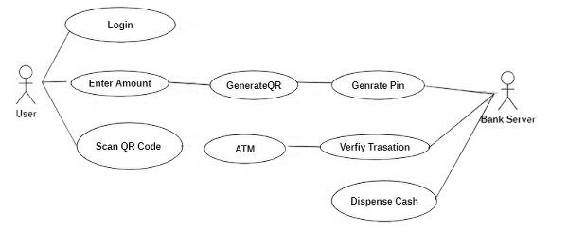
USE CASE DIAGRAM

Slide 17
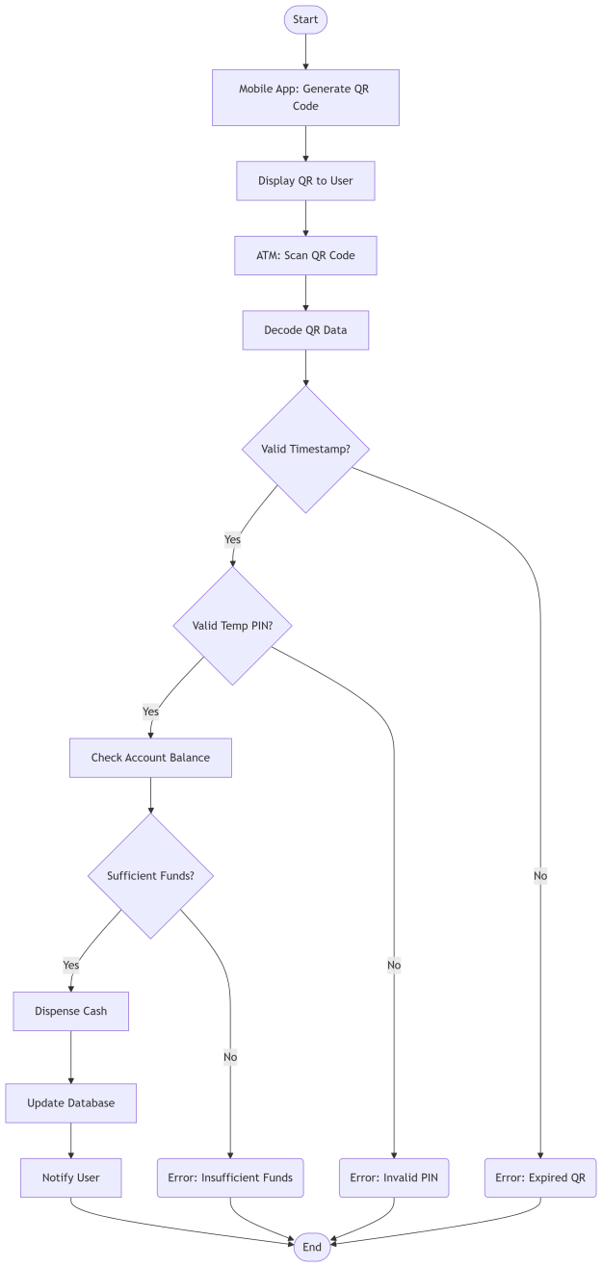
ACTIVITY DIAGRAM

Slide 18
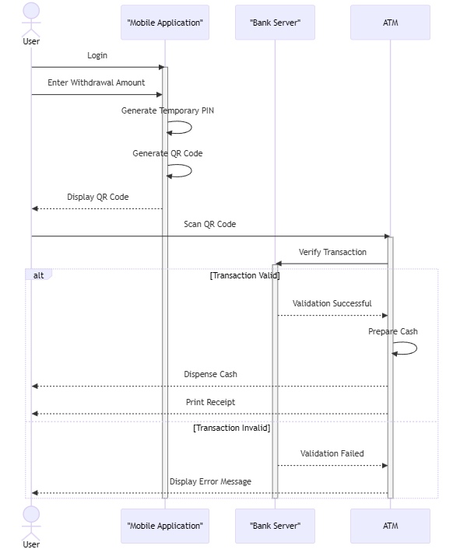
SEQUENCE DIAGRAM

Slide 19
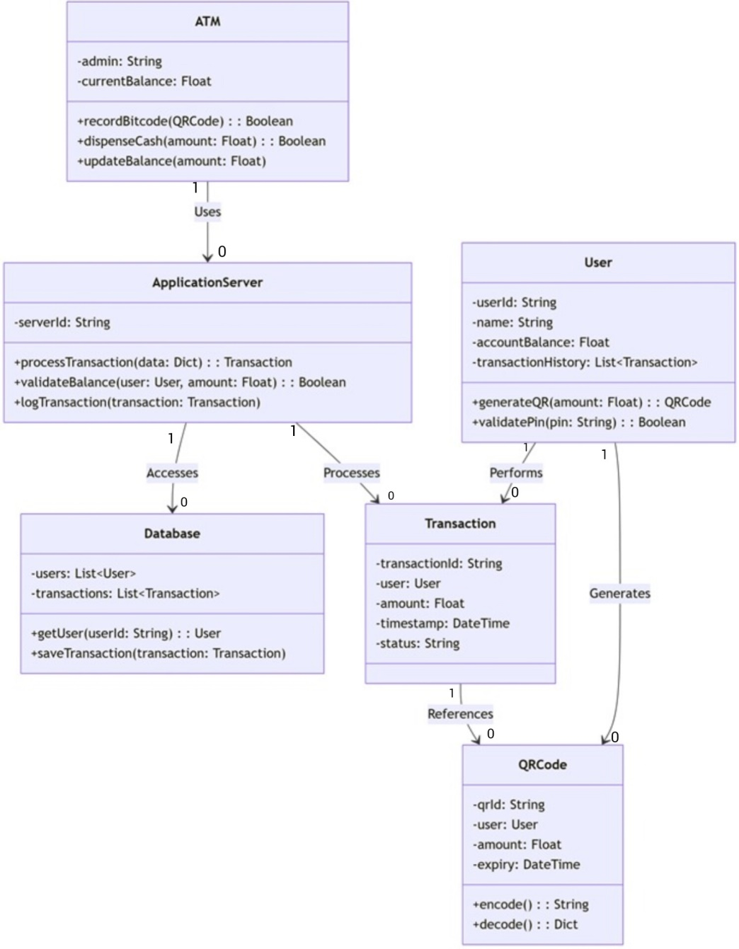
CLASS DIAGRAM

Slide 20
Sample i/p and o/p
Sample I/p and O/P: Mobile App (Input)
// User generates QR code by entering:
{
"action": "generate_qr",
"amount": 5000,
"pin": "2468" // (4-digit secret PIN)
}
// System Output (QR content - encrypted):
"eyJ1aWQiOiJ1c2VyMTIzIiw...<base64_encoded_data>“

Slide 21
Sample i/p and o/p
Sample i/p and o/p: ATM Terminal (Input)
// ATM scans QR and sends to server:
{
"qr_data": "eyJ1aWQiOiJ1c2VyMTIzIiw...",
"atm_id": "ATM_007"
}
// Server validates and responds:
{
"status": "pin_required",
"user_mask": "UserXXXX23",
"amount": 5000
} //(ATM now shows PIN pad)

Slide 22
Sample i/p and o/p
Sample i/p and o/p: PIN Verification (Input)
// User enters PIN at ATM:
{
"pin": "2468" // (Matches QR-embedded PIN)
}
// Server response:
{
"status": "approved",
"transaction_id": "TXN_20250524_123456",
"dispense_amount": 5000
}

Slide 23
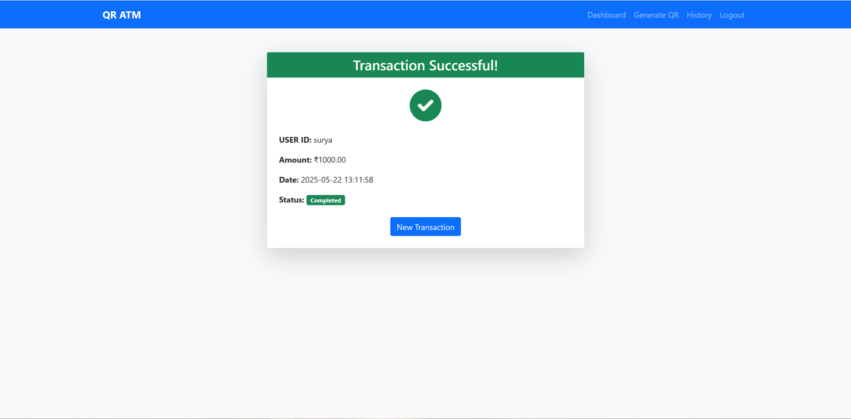
Sample i/p and o/p
Sample i/p and o/p: Cash Dispensing (Output)

Slide 24
CONCLUSION
This project successfully developed a secure and user-friendly QR-based ATM system to improve traditional cash withdrawal methods. Instead of using physical cards and static PINs, the system uses QR codes and temporary PINs to protect users from fraud like card skimming and PIN theft. The process is fast, safe, and contactless.
With tools like Python, Flask, OpenCV, and Pyzbar, the system allows users to log in through a mobile app, generate a QR code, and scan it at the ATM for quick access to their funds. This solution not only makes ATM use easier and faster but also offers better protection and convenience for modern banking needs.

Slide 25
FUTURE ENHANCEMENT
While the Advanced QR-Based ATM System already improves security and removes the need for physical cards, there are ways to make it even better for future use.
Biometric Security Adding fingerprint or face recognition can make the system even safer, especially for large or risky transactions.
Smart Fraud Detection With AI and machine learning, the system can watch for unusual activity, like failed PIN attempts, and stop fraud before it happens.
OTP for Extra Safety Sending a one-time password to the user's phone or email adds another layer of protection, especially for unknown devices

Slide 26
REFRENCES
A. Mehta, R. Singh, and V. Joshi, “Secure ATM transactions using dynamic QR code authentication,” in International Conference on Smart Computing and Communication Technologies (ICSCC), 2021.
S. Kumar and M. Patel, “QR code-based cardless ATM access with biometric validation,” in Proceedings of the 7th IEEE Conference on Cybersecurity and Innovations, 2022, pp. 110–115.
P. Sharma, N. Jain, and K. Verma, “Implementation of secure and contactless banking using mobile QR authentication,” Journal of Network Security and Applications, vol. 9, no. 4, pp. 245–252, 2021.
T. Roy and A. Sinha, “Design of a smart ATM interface using encrypted QR codes,” in Advanced Trends in Computer Science and Information Systems, 2020, pp. 187–192

Slide 27
THANKS!

